Slide 1
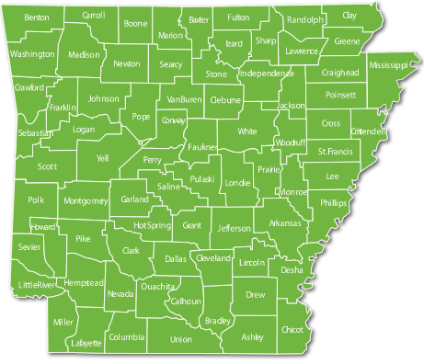
Natural Regions of Arkansas

Slide 2
Six Natural Regions
Ozarks
Arkansas River Valley
Ouachita Mountains
Mississippi Alluvial Plain (Delta)
Gulf Coastal Plain
Crowley’s Ridge

Slide 3
Ozarks
The Ozark region is located in northwest Arkansas.
The region has flat-topped mountains called plateaus and valleys made from rivers.

Slide 4
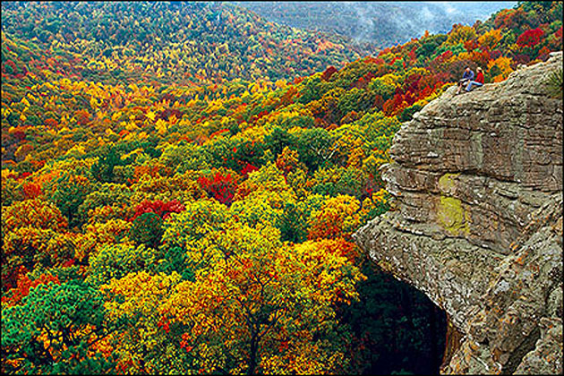
What can you find in the Ozark region?
The Ozark region is home to beautiful plateaus, the University of Arkansas in Fayetteville, and the Walmart headquarters in Bentonville.

Slide 5
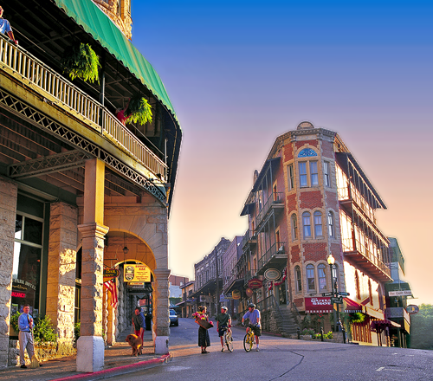
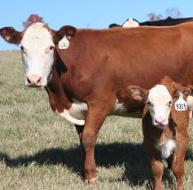
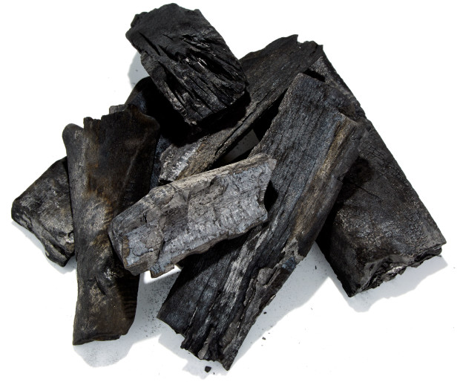
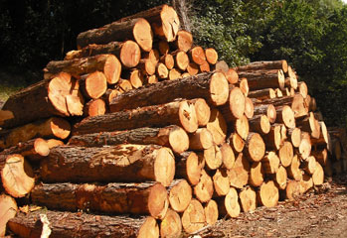
Ozark Resources
Tourists come to this region to take in the beauty of the Ozark mountains and see cities like Eureka Springs.
Beef cattle farms can be found in the Ozark region. The Ozarks also provide lumber yards, and charcoal is made from charred hardwood.

Slide 6
Arkansas River Valley
The Arkansas River Valley was carved out by a wide river.
Many of Arkansas’s large cities are located in the Arkansas River Valley.

Slide 7
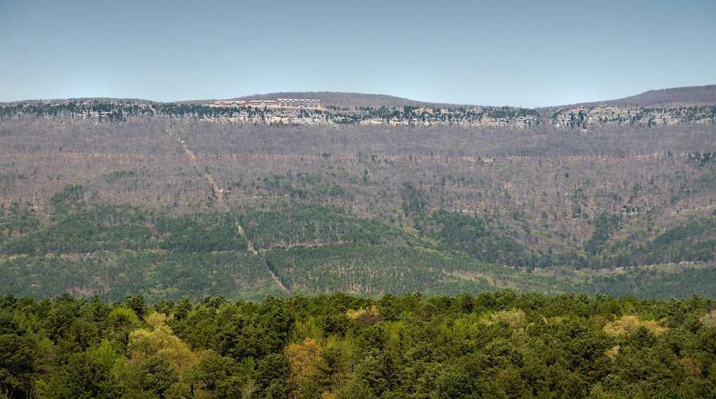
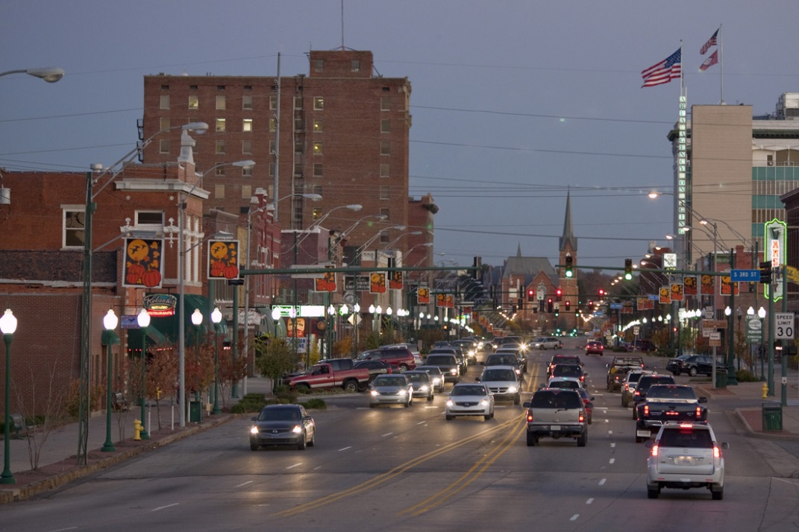
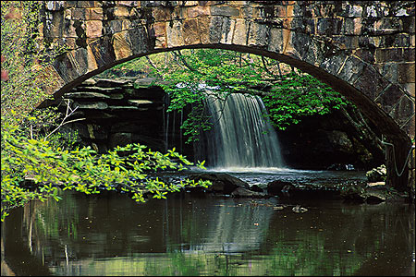
What can you find in the Arkansas River Valley?
(Top) The highest point in Arkansas, Mount Magazine, is in the Arkansas River Valley.
The city of Fort Smith is in the River Valley region.

Slide 8
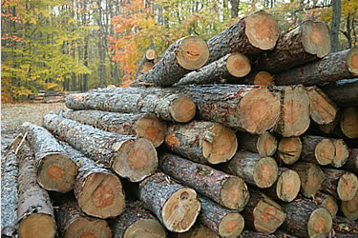
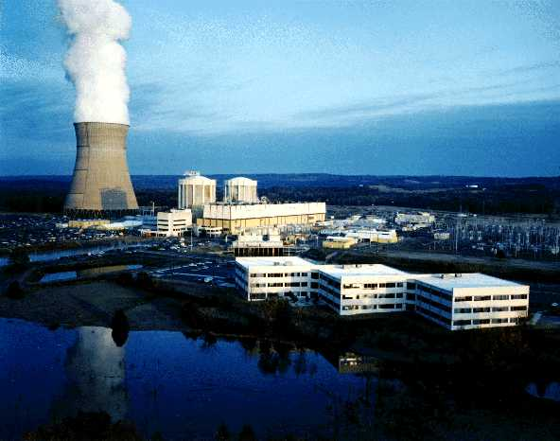
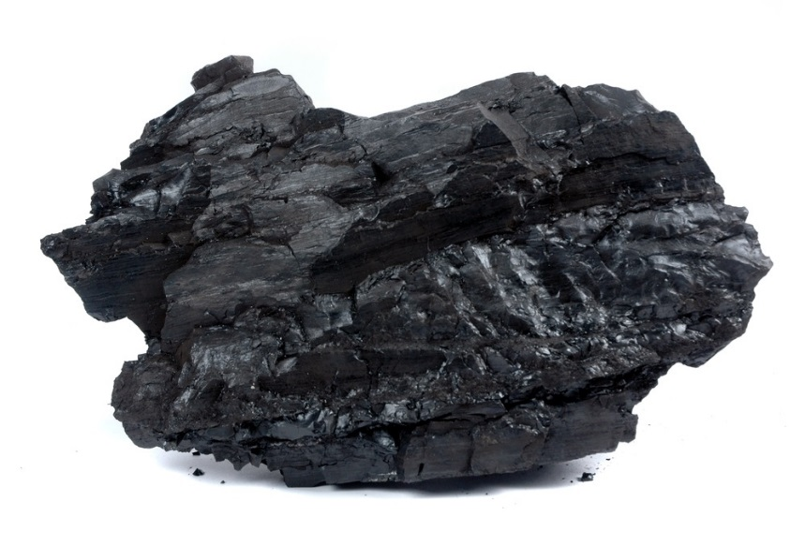
River Valley Resources
The Arkansas River Valley provides coal, timber, natural gas, and nuclear power.

Slide 9
Ouachita Mountains
The Ouachita Mountains are south of the Arkansas River Valley. The ridges run from east to west.
The Ouachita Mountains are home to Hot Springs and part of Little Rock.

Slide 10
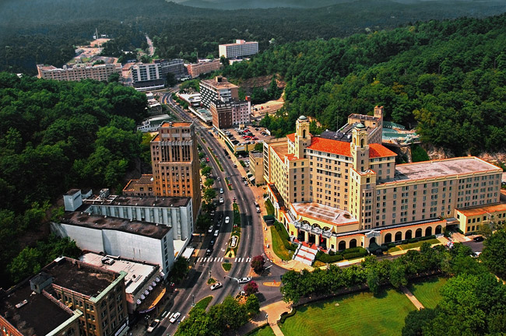
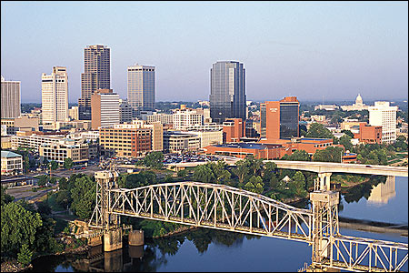
What can you find in the Ouachita Mountains?
Hot Springs and part of Little Rock are located in the Ouachita Mountain region.

Slide 11
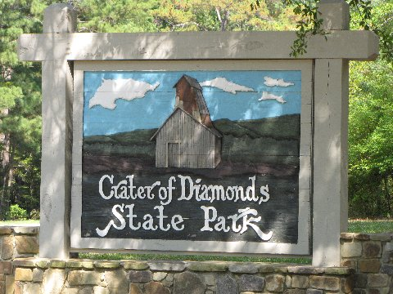
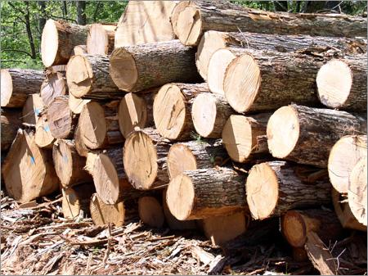
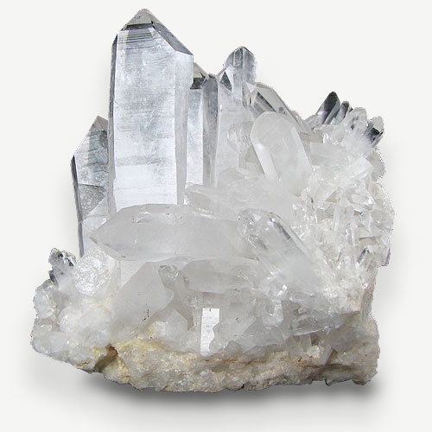
Ouachita Mountain Resources
The Ouachitas are home to several resources. The Crater of Diamonds in Murfreesboro is home to diamonds and minerals like quartz. Hot Springs brings in tourists to the national park and the Oaklawn horse races. The Ouachitas also provide timber.

Slide 12
Mississippi Alluvial Plain
The Mississippi Alluvial Plain, or Delta, is home to rich farmland and is where most of Arkansas’s agriculture comes from.
The Delta is also a land of rivers, wetlands, swamps, and the Grand Prairie.

Slide 13
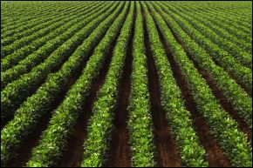
What can you find in the Mississippi Alluvial Plain?
The Delta’s rich soil makes it the perfect place for farmers to grow their crops.
The Delta region is home to blues music and the King Biscuit radio station and blues festival in Helena, Arkansas.

Slide 14
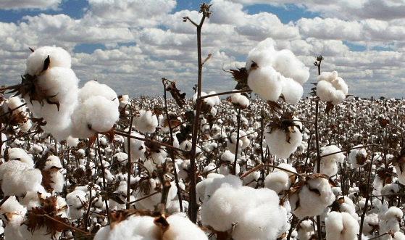
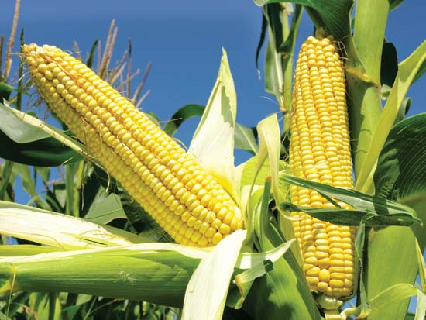
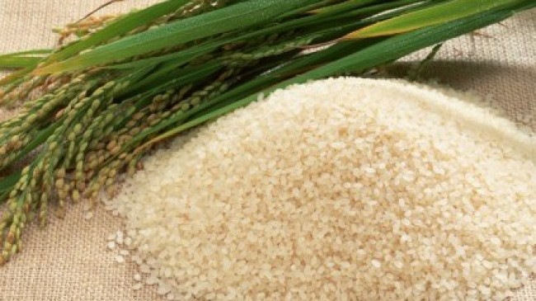
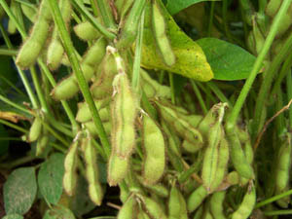
Delta Resources
Corn and soybeans also grown in this region.
Cotton and rice can both be found in the Delta.

Slide 15
Gulf Coastal Plain
The Gulf Coastal Plain is a flat area near the sea. Even though Arkansas is not close to the sea, it used to be millions of years ago!
You will find lots of hills, pine trees, and chalk deposits here.
Texarkana, El Dorado, Camden, and Pine Bluff are located in this region.

Slide 16
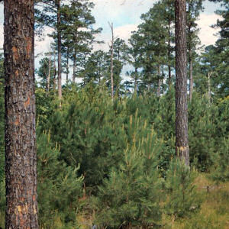
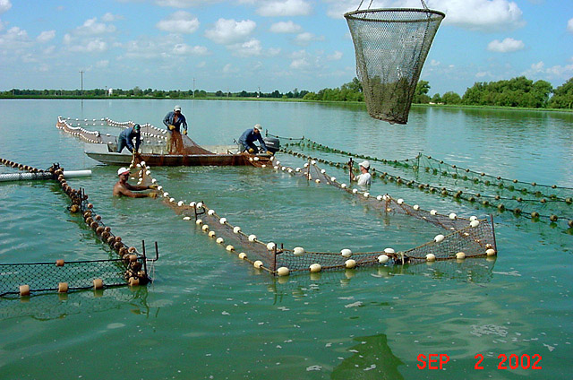
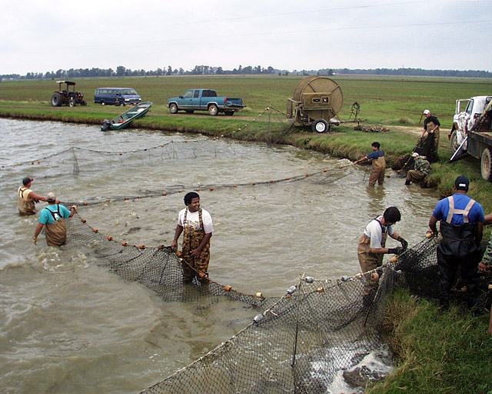
What can you find in the Gulf Coastal Plain?
Aquaculture farms can be found at the University of Arkansas at Pine Bluff. Fishing is popular in the Gulf Coastal Plain region.
Pine trees are abundant in this region.

Slide 17
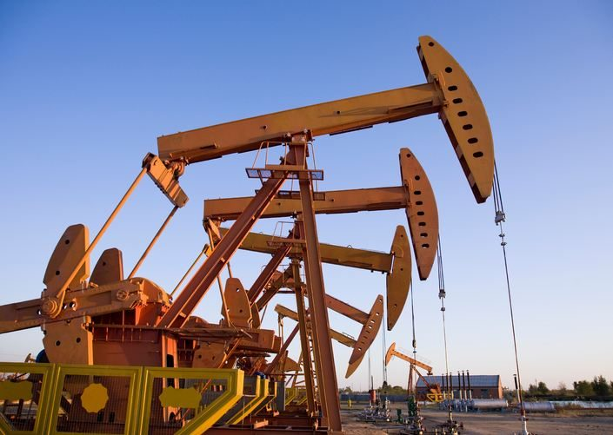
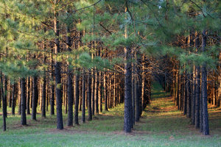
Gulf Coastal Plain Resources
Because this region was covered in water millions of years ago, fossil fuel can be found here. Murphy Oil is located in El Dorado, Arkansas.
Farms, including timber and poultry, are found in this region.

Slide 18
Crowley’s Ridge
The Crowley’s Ridge region is a series of hills that runs north to south through the flat Mississippi Alluvial Plain region.
It’s the only region within another region in Arkansas.
Jonesboro is the largest city in this region.

Slide 19
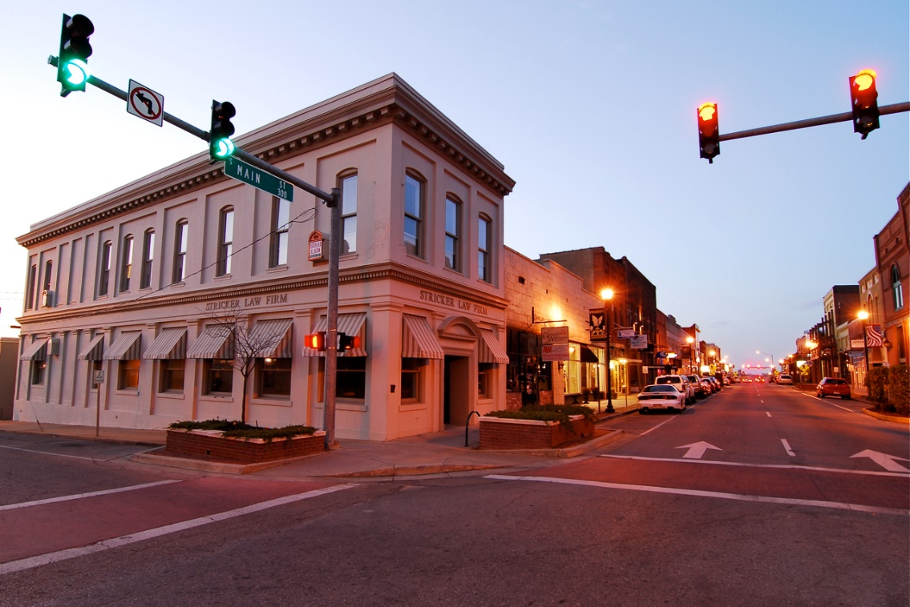
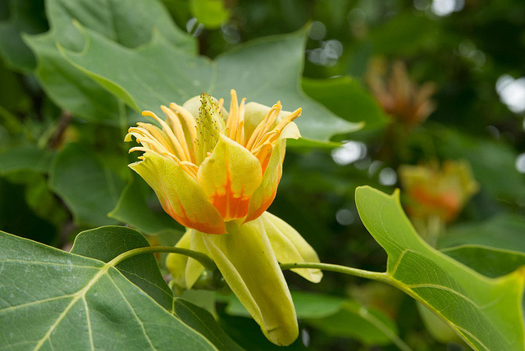
What can you find in Crowley’s Ridge?
Crowley’s Ridge is the only region where you will see a native tulip tree.
Jonesboro is the largest city in Crowley’s Ridge. Arkansas State University calls Jonesboro its home.

Slide 20
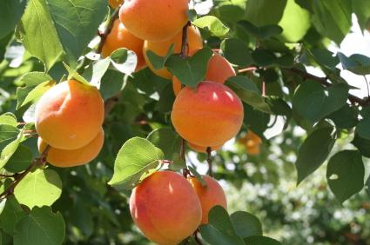
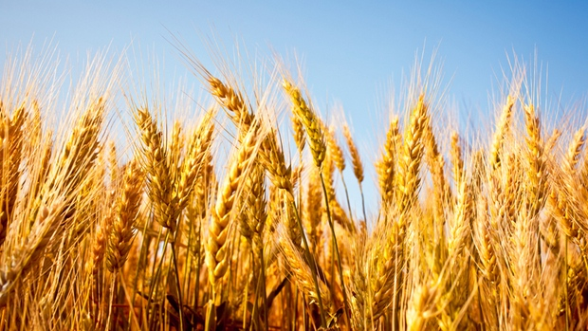
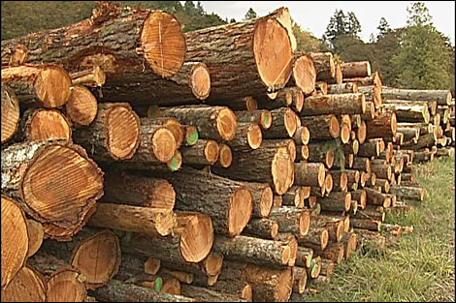
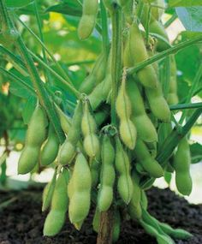
Crowley’s Ridge Resources
Farms are limited due to floodplains, but you can find wheat and soybeans growing in Crowley’s Ridge.
Crowley’s Ridge is a major produce of peach trees. Timber farms are also common here.

Slide 21
Sources
"Arkansas: A Six Region Journey." AETN Arkansas Educational Television Network. Web. 08 July 2016.
"Ecoregions/Natural Divisions of Arkansas." Ecoregions/Natural Divisions of Arkansas. Web. 08 July 2016.
"The Encyclopedia of Arkansas History & Culture." The Encyclopedia of Arkansas History & Culture. Web. 08 July 2016.

