Slide 1
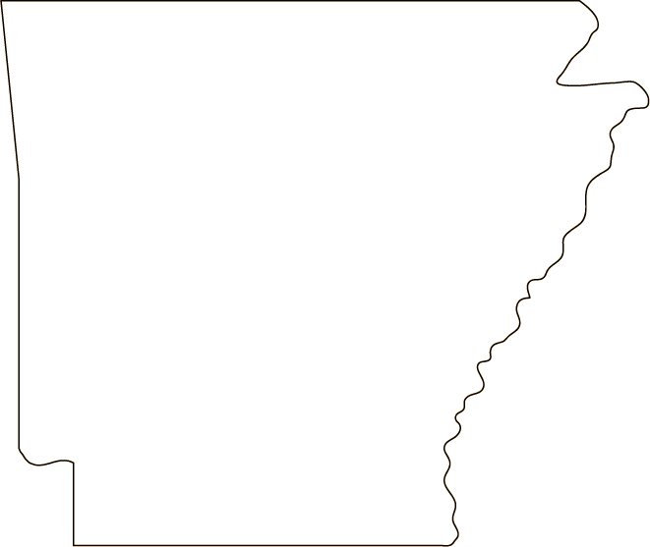
Arkansas: Then and Now

Slide 2
Think About It…
Look at the pictures of Arkansas’s past and present.
What are some of the things you notice about the pictures?
Pay close attention to the people, buildings, cars, and streets.

Slide 3
Questions to Think About
How has Arkansas changed over the years?
How has it stayed the same?
Are the changes good?

Slide 4
Fayetteville
Fayetteville Town Square, 1938
Yale Photogrammar/Dorothea Lange
Fayetteville Town Square, 2011
Wikipedia/Brandonrush

Slide 5
Fort Smith
Garrison Avenue, 1942
Yale Photogrammar/John Vachon
Garrison Avenue, 2006
Wikipedia/Tom Holland

Slide 6
Hot Springs
Hot Springs, 1924
Wikipedia/E.L. Glass
Hot Springs, 2012
Wikipedia/Samuel Grant

Slide 7
Eureka Springs
The Crescent Hotel, 1886
Wikimedia
The Crescent Hotel, 2014
Flickr/Scutter

Slide 8
Little Rock
Little Rock, 1942
Yale Photogrammar/John Vachon
Little Rock, 2008
Flickr/Cliff

Slide 9
Downtown Little Rock
Markham Street, 1890
Littlerock.com
Intersection of Main and Capitol, 1958
The Library of Congress

Slide 10
Downtown Little Rock
River Market, present day
Littlerock.com
River Market, present day
Littlerock.com

Slide 11
Old State House
Old State House, 1934
Wikimedia/ Prather Reynolds
Old State House, 2008
Wikipedia/ Wasted Time R

Slide 12
State Capitol
State Capitol under construction, 1910
Butler Center for Arkansas Studies
State Capitol, 1914
Butler Center for Arkansas Studies

Slide 13
State Capitol
State Capitol, 2007
Arkie.net
State Capitol with Little Rock skyline, present day
Arkansas.com

Slide 14
Capital Hotel, Little Rock
New Capital Hotel, 1910
Detroit Publishing Company
Capital Hotel, 2008
Butler Center for Arkansas Studies

Slide 15
Walmart
The first Walton’s store, 1950.
Wikipedia/Bobak
Walmart, 2014
Flickr/Random Retail

Slide 16
Closing
How has Arkansas changed over the years?
How has it stayed the same?
Are the changes good?

Slide 17
Show What You Know
Make a Venn diagram contrasting Arkansas’s past with its present.
Past
Same
Present

Slide 18
Sources
Weisenfels, J.B. "14 Then And Now Photos In Arkansas That Show Just How Much It Has Changed." OnlyInYourState. OnlyInYourState, 29 Mar. 2016. Web. 29 June 2016.

